Slide 1
A Deep Dive: Exploring the Impact of Maternal Characteristics on Preterm Birth through Multiple and Logistic Regression Analysis
D214: Data Analytics Graduate Capstone
Isiasha Gordon
Western Governs University

Slide 2
Problem
Research Question: What maternal characteristics (e.g. age, ethnicity, education, socioeconomic status) significantly influence the likelihood of preterm birth?
Data analysis through multiple regression and logistic regression modeling will allow for an objective assessment of the relationship between maternal characteristics and preterm birth.
There are no definitive reasons for preterm births. However, there are risk factors that can increase the likelihood of women having a preterm birth.
Some factors for delivering a preterm baby in the past include being pregnant with multiple fetuses, tobacco and/or substance abuse (Premature Birth, 2022).
By identifying specific maternal factors related to preterm birth, healthcare providers can implement targeted interventions, monitoring, and care plans to mitigate the risk and improve patient outcomes.

Slide 3
Hypothesis
Null hypothesis: There is no significant association between individual maternal characteristics and the likelihood of preterm birth.
Alternate Hypothesis: There is a significant relationship between individual maternal characteristics and the likelihood of preterm birth.

Slide 4
Data analysis process
Data collection: Data obtained from NCHS (National Center for Health Statistics) database based on birth certificate regression. Data sourced from an existing database on Kaggle.
Data extraction: relevant variables related to maternal characteristics and preterm birth were selected from the natality database.
Independent variables: birth_year, birth_month, birth_time, birth_place, father_age, mother_education, marital_status, mother_age, father_education , interval_llb , cigarettes, mother_height, mother_bmi, pre_preg_weight, pre_preg_diabetes, gest_diabetes, pre_preg_hypertension, gest_hypertension, infertility_treatment, prev_cesarian, gonorrhea, syphilis, chlamydia, hepatitis_b , hepatitis_c, labor_induction, labor_augmentation, steroids, antibiotics, chorioamnionitis, anesthesia, apgar5, apgar10, plurality, gender, infant_weight
Dependent variable: prev_preterm_birth
Data Cleaning: the data was collected by examining and cleaning data to remove duplicates, errors, or missing variables.
Data preparation: one-hot encoding, univariate analysis, bivariate analysis, heat maps
ver

Slide 5
Data analysis process continued
Normality test completed:
Kolmogorov-Smirnov Test
KS statistic: 0.10665330380822602
p-value: 0.19116286378085373
Shapiro-Wilk Test
Statistic: 0.173
P-Value: 0.0

Slide 6
Multiple regression analysis
used to assess the relationship between individual maternal characteristics and preterm birth
utilized p-values >0.05 and VIF to reduce to the initial model to the final regression model
standardized coefficients
found coefficients and intercept
created residual plot
cross-validation scores
cook's distance
ANOVA

Slide 7
Logistic regression analysis
coefficients indicated the direction and magnitude of association between the maternal characteristics and preterm birth
AIC of the initial and reduced model
cross-validation of the logistic regression model
confusion matrix
found coefficients and intercept
classification report
ROC Curve
variable importance (permutation importance method)

Slide 8
Model comparison
comparison of logistic regression model and random forest metrics
Regulation technique

Slide 9
findings
The following maternal characteristics associated with preterm birth that were identified to be statistically significant were birthplace, mother age, mother education, father education, the interval between last live birth, cigarettes use, delivery weight, use of steroids, plurality, infant weight, marital status, pre-pregnancy diabetes, gestational diabetes, pre-pregnancy hypertension, gestational hypertension, infertility treatment, gonorrhea, hepatitis C, labor induction, labor augmentation, antibiotics usage, and gender.

Slide 10

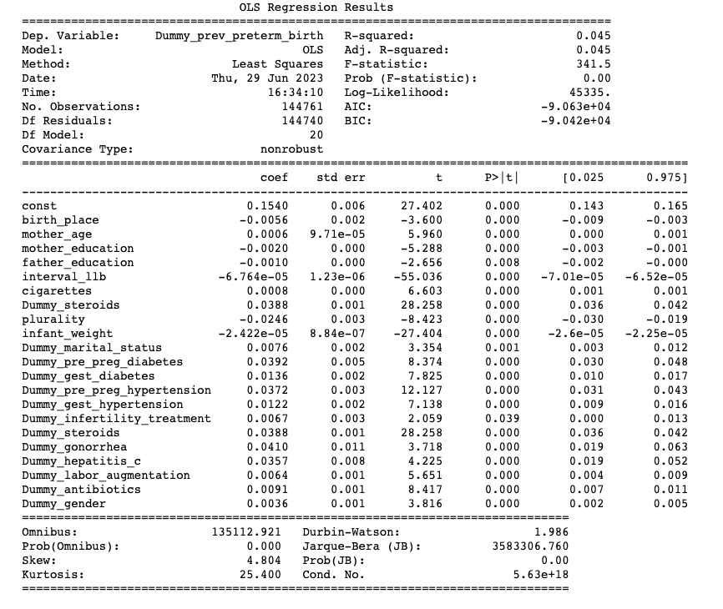
Findings (multiple regression)
The multiple regression analysis indicated an overall good model at predicting preterm birth.
MSE= 0.313 suggesting the predicted values deviated from the actual values by a small amount
RSE= 0.177 suggesting there is some remaining amount of variation in the data that is not explained by the multiple regression model
The null hypothesis of this analysis was rejected.

Slide 11

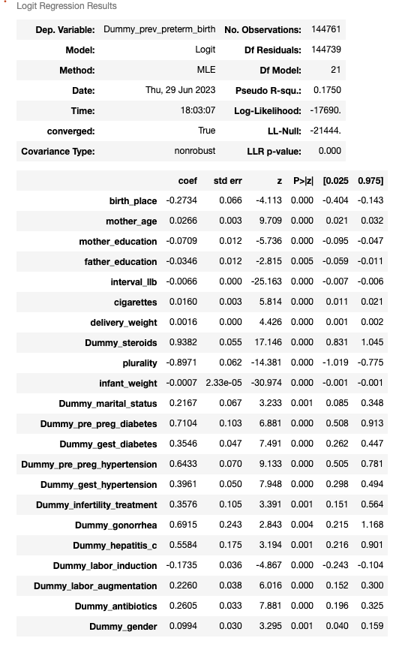
Findings (logistic regression)
Positive coefficients: indicate an increase in the respective independent variable associated with an increase in the likelihood of preterm birth. The variables with positive coefficients were: steroid use, martial status, diabetes prior to pregnancy, hypertension prior to pregnancy, gestational hypertension, Infertility treatments, gonorrhea, hepatitis C, labor augmentation, antibiotic use, and gender.
Negative coefficients: indicate a decrease in the likelihood of preterm birth associated with an increase in the respective independent variable. The variables with negative coefficients were: birthplace, mother's education, father's education, interval between the last live birth, cigarette use, delivery weight, plurality (multiple births), infant weight, and labor induction.
The logistic regression model struggled to correctly identify instances of preterm birth indicated (positive class) by a low recall, precision, and F1-score. However, the model performed well in predicting term births (negative class)

Slide 12
limitations
The sourced data from Kaggle used in this analysis had limited variables compared to the original NCHS dataset.
The dataset used only contains data for one year which limits the ability to capture trends and generalize findings over time.
multicollinearity is a limitation in multiple regression analysis. This can occur when independent variables are highly correlated with each other making it difficult to determine the independent effects on the dependent variable.
The analysis focused on finding correlations between maternal characteristics and preterm birth, but it is difficult to establish causation due to potential confounding factors.

Slide 13
Limitations continued
There is limited information on maternal and paternal characteristics and the absence of socioeconomic factors that could contribute to preterm birth.
The regression models used in the analysis rely on assumptions such as linearity, independence, and absence of multicollinearity. violations of these assumptions can affect the validity of the results of the data.
The limited number of independent variables used in the analysis may not fully capture all the factors that influence preterm birth.
This analysis does not account for the variability in underlying factors contributing to preterm birth among women who have had a previous preterm birth.

Slide 14
Recommended actions
The models did well at predicting term births but not preterm births in relation to maternal characteristics.
It is recommended that model be expanded with more independent variables.
Other possible factors influencing preterm birth that could include race, substance abuse, inadequate prenatal care, healthcare resource availability, or hormonal imbalances.
Further investigation should be conducted to determine maternal characteristics influencing preterm birth to understand specific factors and characteristics that contribute to preterm birth to provide valuable insights on prevention and intervention strategies.
It is recommended there be external validation. Validating the findings and model on another dataset that is similar should be done to assess the generalizability of the results.

Slide 15
Recommendations continued
One future approach for further studying would be to complete a longitudinal analysis.
A longitudinal analysis can provide insight into patterns and changes in risk factors associated with preterm birth and offer multiple time points during pregnancy and during postpartum care for a dynamic assessment and investigation into maternal characteristics.
Another approach for future study would be to look further into causal inferences. Using casual inference methods can establish a causal relationship between specific risk factors and preterm birth.

Slide 16
Benefits of study
Through multiple regression and logistic regression modeling the analysis allowed for an objective evaluation of the relationship between maternal characteristics and preterm birth.
The study identified serval maternal characteristics that were found to be significant predictors of preterm birth including birthplace, mother's age, mother's education, father's education, tobacco use, delivery weight, use of steroids, and various medical conditions. These findings contribute to the understanding of the factors associated with preterm birth.
By identifying specific maternal factors related to preterm birth, healthcare providers can implement targeted interventions, monitoring, and care plan to mitigate risk and improve patient outcomes. This can help reduce the incidence of preterm birth and improve the health and patient outcomes of both the mother and baby.

Slide 17
Benefits continued
This study rejects the null hypothesis that there is no significant association between individual maternal characteristics and the likelihood of preterm birth.
The findings support the alternative hypothesis and provide evidence for the existence of significant relationships between maternal characteristics and preterm birth, prompting further investigation.
This analysis emphasizes the complex nature of predicting preterm birth and highlights the need for further research and model improvement.
By recognizing the limitations of this analysis, researchers can refine their methods and explore additional variables that may influence preterm birth such as race, prenatal care, healthcare resource availability, or hormonal imbalances.
This analysis contributes to the existing body of knowledge on preterm birth by providing insights into the favors influencing critical health outcomes.

Slide 18
sources
Brittain, Jim; Cendon, Mariana; Nizzi, Jennifer; and Pleis, John (2018) "Data Scientist’s Analysis Toolbox: Comparison of Python, R, and SAS Performance," SMU Data Science Review: Vol. 1: No. 2, Article 7. https://scholar.smu.edu/datasciencereview/vol1/iss2/7
Brownlee, J. (2019a). Use Weight Regularization to Reduce Overfitting of Deep Learning Models. MachineLearningMastery.com. https://machinelearningmastery.com/weight-regularization-to-reduce-overfitting-of-deep-learning-models/
Bruce, P., Bruce, A., & Gedeck, P. (2020a). Practical Statistics for Data Scientists: 50+ Essential Concepts Using R and Python (2nd ed.). O’Reilly Media.
Collins, L. M., Schafer, J. A., & Kam, C. (2001). A comparison of inclusive and restrictive strategies in modern missing data procedures. Psychological Methods, 6(4), 330–351. https://doi.org/10.1037/1082-989x.6.4.330
Data Access - Vital Statistics Online. (n.d.). https://www.cdc.gov/nchs/data_access/vitalstatsonline.htm#Tools
Daniel T. Larose, & Chantal D. Larose. (2019). Data Science Using Python and R. Wiley.
Edgar, T. F., & Manz, D. O. (2017). Exploratory Study. In Elsevier eBooks (pp. 95–130). https://doi.org/10.1016/b978-0-12-805349-2.00004-2
Fuchs, F., Monet, B., Ducruet, T., Chaillet, N., & Audibert, F. (2018). Effect of maternal age on the risk of preterm birth: A large cohort study. PLOS ONE, 13(1), e0191002. https://doi.org/10.1371/journal.pone.0191002
GeeksforGeeks. (2022). Violin plot using Seaborn in Python. GeeksforGeeks. https://www.geeksforgeeks.org/violinplot-using-seaborn-in-python/
Luna, J. C. (2022, December 28). Python vs R for Data Science: Which Should You Learn? https://www.datacamp.com/blog/python-vs-r-for-data-science-whats-the-difference
Massaron, L. (2016). Regression analysis with python: Learn the art of regression analysis with python. Packt Publishing.
Multiple Regression. (n.d.). https://home.csulb.edu/~msaintg/ppa696/696regmx.htm
Narkhede, S. (2022, March 5). Understanding AUC - ROC Curve - Towards Data Science. Medium. https://towardsdatascience.com/understanding-auc-roc-curve-68b2303cc9c5
National Vital Statistics System (NVSS) - Health, United States. (n.d.). https://www.cdc.gov/nchs/hus/sources-definitions/nvss.htm
Premature Birth. (2022, November 1). Centers for Disease Control and Prevention. https://www.cdc.gov/reproductivehealth/features/premature-birth/index.html#:~:text=Some%20risk%20factors%20for%20preterm,has%20to%20be%20delivered%20early
Turvey, B. E. (2013). Multivariate Analysis of Forensic Fraud, 2000–2010. In Elsevier eBooks (pp. 157–182). https://doi.org/10.1016/b978-0-12-408073-7.00009-4
USA Natality 2020. (2022, April 20). Kaggle. https://www.kaggle.com/datasets/shayta/usa-natality-2020
What is Analysis of Variance (ANOVA)? (n.d.). TIBCO Software. https://www.tibco.com/reference-center/what-is-analysis-of-variance-anova#:~:text=Sign%20In-,What%20is%20Analysis%20of%20Variance%20(ANOVA)%3F,the%20means%20of%20different%20groups

